Slide 1
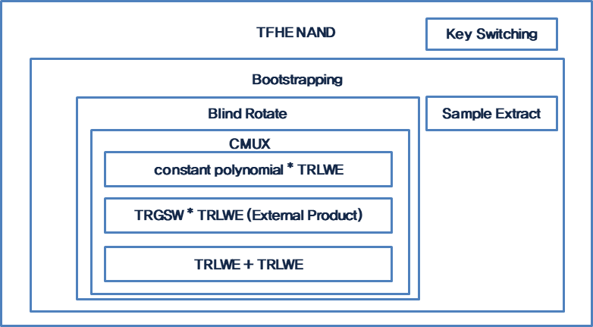
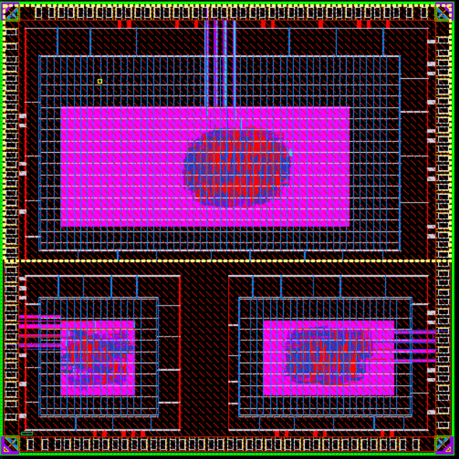
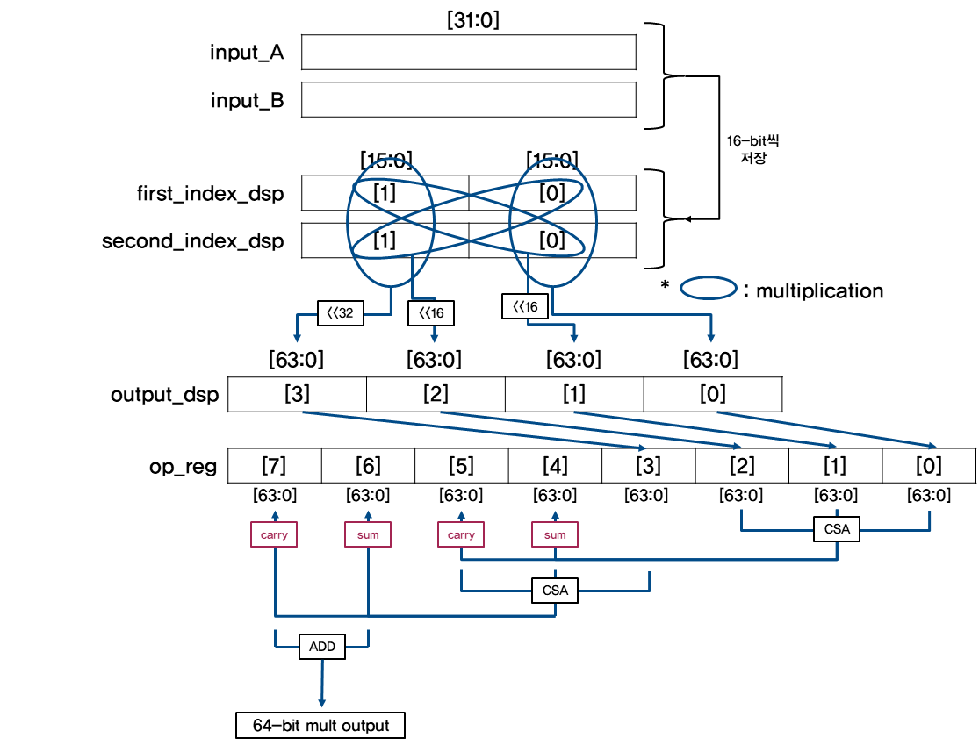
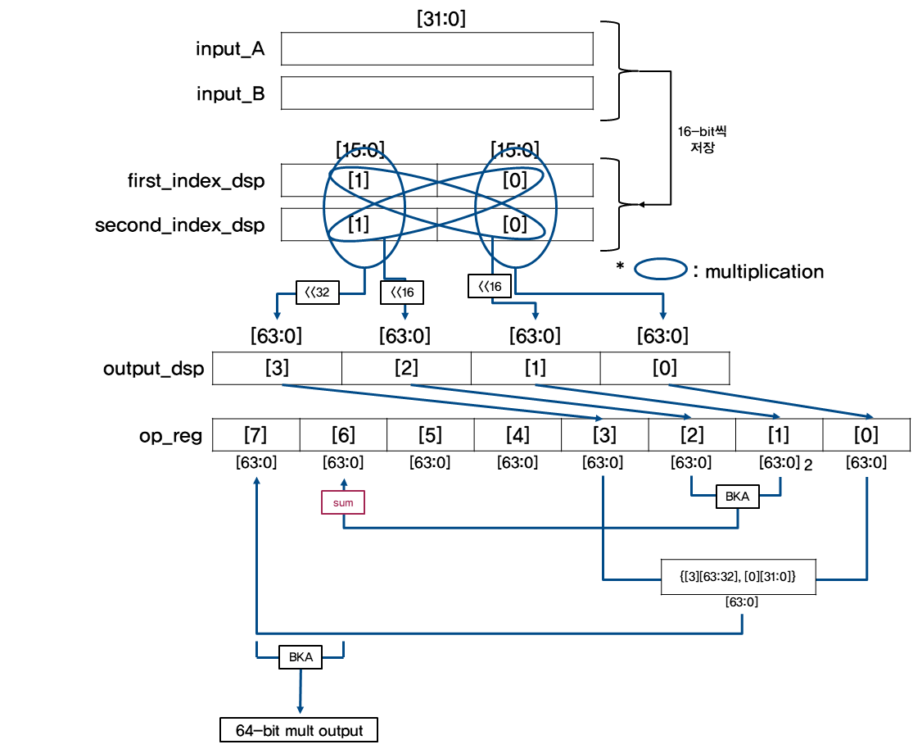
Homomorphic Encryption HW implementation Research
Hee Seung Lee, Seon Bhin Kim and Dong Kyue Kim
Department of Electronic Engineering, Hanyang University, Seoul 133-710, Korea
Introduction
Research Background
If quantum computer is commercialized, It is expected that Existing cryptosystem will be destroyed
Preoccupying Homomorphic Encryption technology is the important part of the market of crypto in
the situation that the throughput of data is being skyrocketed
By implementing Homomorphic Encryption by HW, Possibility of commercialization can be checked
As TFHE Scheme among Homomorphic Encryption Schemes needs improvement at calculation time for
commercialization , We need to implement high speed module and analyze it
Homomorphic Encryption
The way to be able to calculate using encrypted data
Among Homomorphic Encryption Schemes, TFHE Scheme is one of GSW-like Scheme which conducts
bootstrapping frequently and has pros that it’s rate of increase of noise is lower and it’s calculation
procedure is more simple than BGV-like Scheme
Implementation
TFHE NAND
The most time consuming part in bootstrapping at the TFHE NAND calculation is CMUX
One operation of CMUX needs 0.022ms and External Product takes most of that time
We tried to improve performance by designing high speed External Product calculation
 | 소요 시간 (ms)
TFHE NAND | 15
Key switching | 1.5
Boostrapping | 13.5
Sample Extract | 0.000001
Blind Rotate | 13.499999 ( 630 0.022 )
constant polynomial * TRLWE | 0.001
TRGSW * TRLWE (External Product) | 0.02
TRLWE + TRLWE | 0.001
X4
X1
X2
Analysis Result
External Product
Layout
Result and Discussion
Operation time was decreased by improving
performance of calculator from this result
It is expected that referencing this result will
be helpful when the high speed calculator is
needed
Acknowledgement
This Research was supported with MPW from IDEC

